Slide 1
Unit - 2
Advanced Excel for Data Manipulation and Analysis

Slide 2
Syllabus
Excel Data Manipulation Techniques: Sorting and filtering data, Basic Functions (SUMIF and SUMIFS, COUNTIF and COUNTIFS, AVERAGEIF and AVERAGEIFS, IFERROR, CHOOSE, TEXTJOIN, TRANSPOSE, CONCATENATE, SUBTOTAL, INDIRECT, OFFSET, etc.) Advanced functions (VLOOKUP, INDEX, MATCH, etc.), Text-to-columns and data cleansing, Data validation and conditional formatting. Excel Data Analysis Tools: PivotTables and PivotCharts, What-If analysis and Scenario Manager, Data tables and Goal Seek, Solver add-in for optimization.

Slide 3
Excel data manipulation
Data Manipulation is the modification of information to make it easier to read or more structured.
For example, a data log may be sorted in alphabetical order, making it easier to find individual entries.

Slide 4
Excel Data Manipulation Techniques
Filtering
Sorting
Grouping
Pivoting
Transposing
Changing Data Types
Adding Columns and Rows
Naming Columns or Rows
Inserting Columns or Rows

Slide 5
Filtering
Filtering is a process of sorting data by a certain criteria.
It’s an effective way to identify subsets of data from the larger dataset.
Sorting
Sorting is another technique of data analysis and is used to rearrange the order of our data.
It’s an easy way of exploring and understanding our data.
Grouping
Grouping is an excellent way to analyze your data.
Grouping is when you organize data into smaller sets.
We can use this technique to make it easier to analyze the relationships in our data like quantifying averages, totals, and percentages.

Slide 6
Pivoting
Pivoting data involves taking a data table and turning it on its side to show an aggregate perspective.
For example, let’s say you have a list of monthly income brackets and want to see the monthly income distribution for each bracket.
That is you want to see how many people fall in certain income brackets.
Transposing
Data can be transposed by using the Excel TRANSPOSE function.
It is a very efficient way to take any data, for example: lets say our data is organized horizontally like below

Slide 7
5 10 15 20 25 and we would like to turn it into a vertical format like this:
5
10
15
20
25
the Transpose function can help out in this case.
Changing Data Types
One thing that might be useful to know is how changing data types can affect your data analysis. This can be done through excel text functions.

Slide 8
Two different types of data are text and number.
For example, a person’s name or the title of a book. Numeric data will always be numbers based and may only have numbers in them, such as 3.1, 4.5, and so on.
If you want to change the type of your data from one type to another, you can change the data type as Data→Data Type→Text or Number.
Adding Columns and Rows
Adding columns or rows to your data is a great way to make your work more efficient.
To name columns and rows in Excel, first select the cells that need naming. Then go to Data > Data Tools > Name Columns and Rows and type the name of the first cell into the first dialogue box.

Slide 9
Inserting Columns or Rows
One of the simplest data manipulation techniques in Excel is inserting columns or rows.
This technique lets you analyze your data with more clarity and precision by adding more columns or rows to your spreadsheet.
It can be used to show different aspects of your data, such as different years, regions, products etc.

Slide 10
Basic Functions of Advanced Excel
SUMIF/COUNTIF & SUMIFS/COUNTIFS Functions
I have clubbed these four functions together as they have the same modus-operandi.
For example, if you have a list of names, and you want to quickly count how many times a specific name appears in the list, you can use the COUNTIF formula.

Slide 11
similarly, if you have a data set where you have the Sales Rep names and their sales values, and you want to get the sum of all the sales done by a specific sales Rep, you can use the SUMIF function.
In case you need to check for multiple conditions, you can use the COUNTIFS or SUMIFS formulas.

Slide 12
SORT & SORTBY Function
These are two new functions in Excel 2021 and Excel for Microsoft 365.
Using the SORT function, you can quickly sort any data set based on the specified row or column.
It also gives you the flexibility to choose the sort order (i.e., ascending or descending).
So if you have a data set and you want to sort this data based on one specific column, you can use the SORT function.
The SORTBY function provides a little more functionality while sorting the data using a formula.
With this function, you can sort based on multiple columns.

Slide 13
TEXTJOIN Function
TEXTJOIN allows you to quickly combine the content of a selected range of cells without creating along concatenate formula or using the & sign a gazillion times.
It also allows you to specify a delimiter such as a space character or a comma, so that all the combined cells would have that delimiter between the content of the cells.

Slide 14
IFS Function
Used for multiple conditions.
Ex - if you’re a teacher grading students or a manager who needs to decide how much Commission your sales reps get based on their sales value.
you don’t need to create long convoluted IF formulas, instead, you can use the IFS function.

Slide 15
IFERROR Function
If Excel sheet is full of errors such as #N/A or #REF! or #DIV/0!.
While getting these errors may be out of your control sometimes, IFERROR allows you to handle these errors by replacing them with something more meaningful.
such as “Look-up value not found” or “Data not available”.

Slide 16
OFFSET Function
OFFSET function can be used in very specific situations
most advanced Excel users would rarely need to use it.
OFFSET function allows you to offset the reference by this specified number of rows or columns.

Slide 17
VLOOKUP Function
VLOOKUP in Excel stands for Vertical Lookup.
VLOOKUP function searches for specific values (vertically) in a column and retrieves exact or approximate matches from another column from the same row.
When to use it?
Find product price based on product code
Find a city based on its zip code
Get the employee’s ID based on name
Find commission based on sales, etc.

Slide 18
XLOOKUP Function
XLOOKUP function in Excel searches for lookup value vertically and horizontally in the table or array and returns the result from the same row.
When to use it?
To search the contact number of a particular customer
To find the city name based on the pin or zip code
To search the salary of employees based on their ID
To see sales of specific products, etc.

Slide 19
INDEX Function
The INDEX function finds the cell where the specified row number and column number meet in the given range and then returns the value present in that cell.
When to use it?
To get a student’s grade for a particular subject
To retrieve a product’s sales revenue for a particular region, etc.

Slide 20
MATCH Function
The MATCH function in Excel returns the position of the given value in a row or column.
When to use it?
To find the exact position of a customer’s contact no. from a list
Using a student’s name to find the row where the student’s details are present
To find the “Out of stock” item to check inventory status, etc.

Slide 21
CONCATENATE Function
CONCATENATE in Excel is an important function that combines data from different cells and displays the result in a single cell.
When to use it?
To combine first name and last name
To combine pin code and city name for generating address
To combine domain and page name to create website URL, etc.

Slide 22
Functions
TRIM
The TRIM function in Excel removes any unwanted or extra spaces from the beginning, in between, or end of a text.
LEN
The LEN function in Excel returns the number of characters present in a given text string or data.
CONVERT
CONVERT is an advanced Excel formula that converts a number from one measurement unit to another.

Slide 23
REPLACE and SUBSTITUTE Functions
The REPLACE function in Excel replaces a specific number of characters in a given text.
On the other hand, the SUBSTITUTE function replaces the entire text string with another text.
CHOOSE Function
You can use the CHOOSE function in Excel to pick a specific value from a list of values by mentioning its position in the list.

Slide 24
ROUND Function
The ROUND function in Excel lets us decide if we want a numerical value to have any decimal points or not, and if yes, how many decimal places the number should have.
UNIQUE Function
The UNIQUE function in Excel returns a list of unique values in a given range.

Slide 25
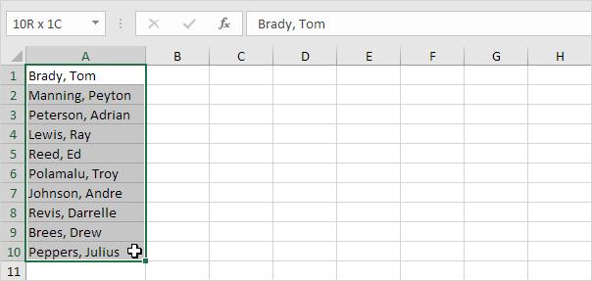
Text-to-columns
1. Select the range with full names.

Slide 26
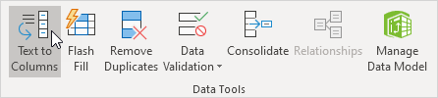
2. On the Data tab, in the Data Tools group, click Text to Columns.
3. Choose Delimited and click Next.

Slide 27
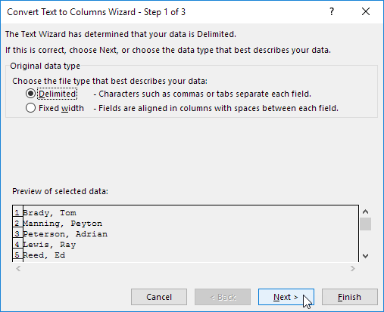

Slide 28
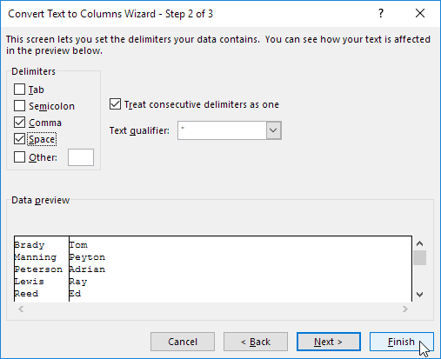
4. Clear all the check boxes under Delimiters except for the Comma and Space check box.
5. Click Finish.

Slide 29
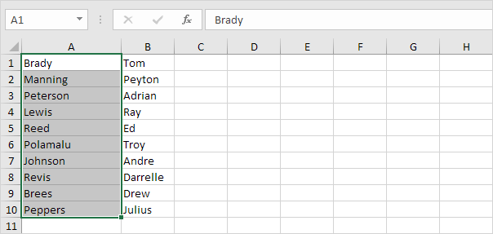

Slide 30
Data cleansing
Data cleaning is the process of fixing or removing incorrect, corrupted, incorrectly formatted, duplicate, or incomplete data within a dataset.
When combining multiple data sources, there are many opportunities for data to be duplicated or mislabeled.

Slide 31
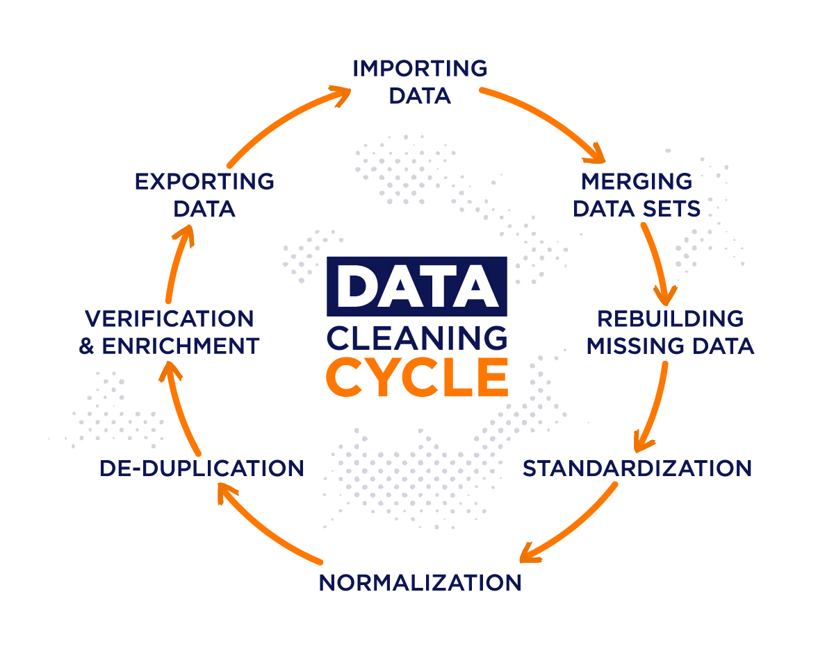

Slide 32
Data validation
Data validation means checking the accuracy and quality of source data before using, importing or otherwise processing data.
Different types of validation can be performed depending on destination constraints or objectives.
Step 1: Determine Data Sample. If you have a large amount of data to validate, you will need a sample rather than the entire dataset.
Step 2: Database Validation. You must ensure that all requirements are met with the existing database during the Database Validation process.
Step 3: Data Format Validation.

Slide 33
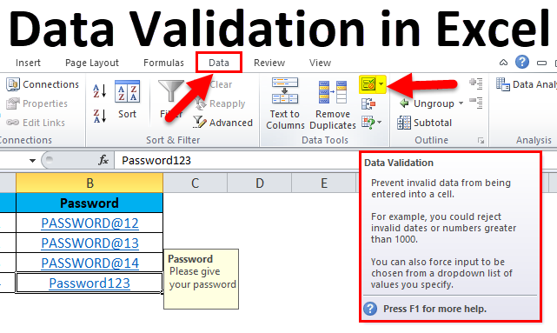

Slide 34
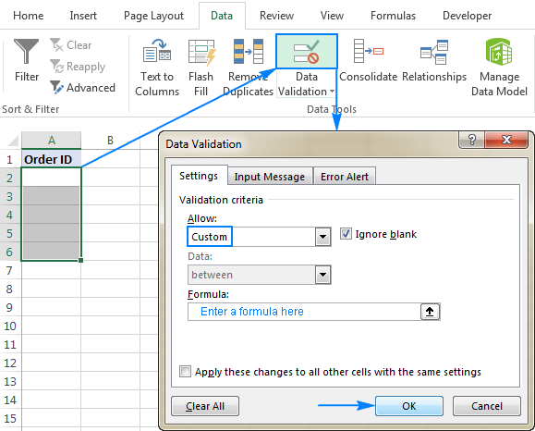

Slide 35
Conditional formatting
Conditional formatting is used to change the appearance of cells in a range based on your specified conditions.
The conditions are rules based on specified numerical values or matching text.

Slide 36
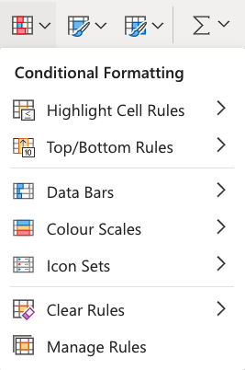

Slide 37
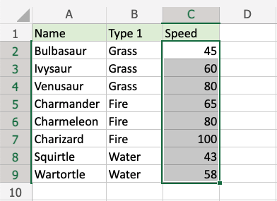
Conditional formatting step by step:
Select the range of Speed values C2:C9

Slide 38
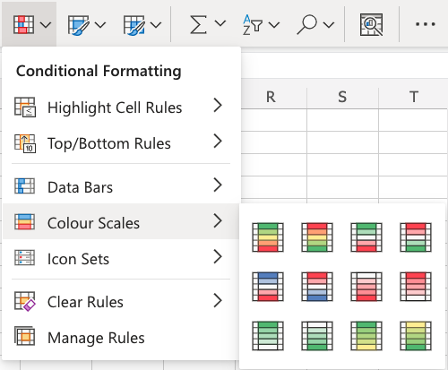
2) Click on the Conditional Formatting icon in the ribbon, from the Home menu.
3) Select the Color Scales from the drop-down menu.

Slide 39
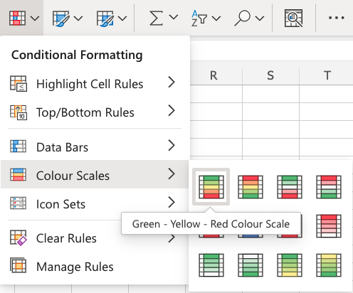
There are 12 Color Scale options with different color variations.
The color on the top of the icon will apply to the highest values.
4) Click on the "Green - Yellow - Red Colour Scale" icon.

Slide 40
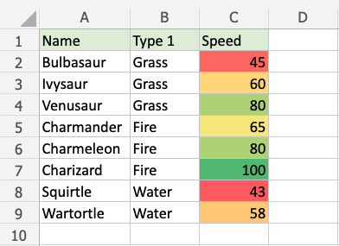
Now, the Speed value cells will have a colored background highlighting:

Slide 41
Excel Data Analysis Tools:
PivotTables and PivotCharts
PivotTable used to summarize, analyze, explore, and present summary data.
PivotCharts complement PivotTables by adding visualizations to the summary data in a PivotTable and allow you to easily see comparisons, patterns, and trends.

Slide 42
The Insert Chart dialog box lets you choose from a variety of PivotChart types.
Some chart types will be better at displaying certain data than others.
The most common types of charts are Column, Bar, Line, and Pie.
Column and Bar charts work well to compare different sets of data against each other.

Slide 43
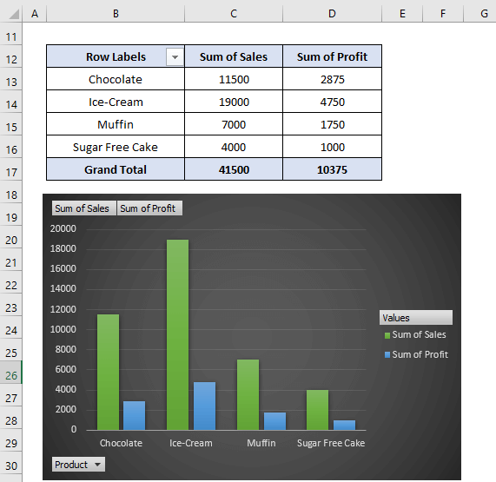

Slide 44
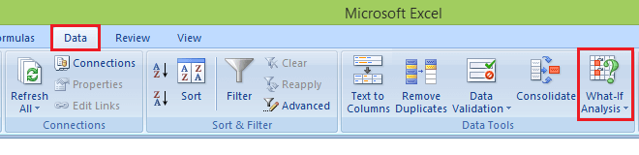
What-If analysis and Scenario Manager:
What-if analysis is a process of changing cells' values to see how those changes will affect the worksheet's outcome.
To enable the what-if analysis tool go to the Data menu tab and click on the What-If Analysis option under the Forecast section.
Now click on the What-If Analysis. Excel has the following What-if analysis tools that can be used based on the data analysis needs:

Slide 45
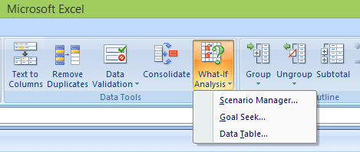
Scenario Manager
Goal Seek
Data Tables
Data Tables and Scenarios take sets of input values and project forward to determine possible results.
Goal seek differs from Data Tables and Scenarios in that it takes a result and projects backward to determine possible input values that produce that result.

Slide 46
1. Scenario Manager
A scenario is a set of values that Excel saves and can substitute automatically in cells on a worksheet. Below are the following key features:
You can create and save different groups of values on a worksheet
Then switch to any of these new scenarios to view different results.
A scenario can have multiple variables, but it can accommodate only up to 32 values.
You can also create a scenario summary report, which combines all the scenarios on one worksheet.
Scenario Manager is a dialog box that allows you to save the values as a scenario and name the scenario.

Slide 47
2. Goal Seek
Goal Seek is useful if you want to know the formula's result but unsure what input value the formula needs to get that result.
For example, if you want to borrow a loan and know the loan amount, tenure of loan and the EMI that you can pay, you can use Goal Seek to find the interest rate at which you can avail of the loan.
Goal Seek can be used only with one variable input value.
If you have more than one variable for input values, you can use the Solver add-in.

Slide 48
3. Data Table
A Data Table is a range of cells where you can change values in some of the cells and answer different answers to a problem.
For example, you might want to know how much loan you can afford for a home by analyzing different loan amounts and interest rates.
You can put these different values and the PMT function in a Data Table and get the desired result.
A Data Table works only with one or two variables, but it can accept many different values for those variables.

Slide 49
Solver add-in for optimization
The Excel Solver add-in is especially useful for solving linear programming problems likes linear optimization problems and therefore is sometimes called a linear programming solver.
Apart from that, it can handle smooth nonlinear and non-smooth problems.
Use Solver to find an optimal (maximum or minimum) value for a formula in one cell called the objective cell — subject to constraints, or limits, on the values of other formula cells on a worksheet.

Slide 50

Solver is located on the Data tab in the Analyze group
If you can’t see it and you are using a version of Excel that supports Solver, you will need to load the add-in.
Click on the File tab
Click Options
Click Add-ins
Select Excel Add-ins
Place a tick next to Solver
To add the Solver, if it isn’t already there, go to the Add-ins section under the Options menu. Select Excel Add-ins and place a tick next to Solver. Click OK.

Slide 51
Assignment - 2
Explain Excel Data Manipulation Techniques
Describe Basic Functions of Advanced excel
Explain the following terms:
Text-to-columns
Data cleansing
Data validation
Conditional formatting
Describe Excel Data Analysis Tools
PivotTables and PivotCharts
What-If analysis
Scenario Manager, Data tables and Goal Seek
Solver add-in for optimization.

